Slide 1
UPAVLJAČKI ALGORITMI U REALNOM VREMENU Digitalno upravljanje dinamičkim sistemima
The European Commission's support for the production of this publication does not constitute an endorsement of the contents, which reflect the views only of the authors, and the Commission cannot be held responsible for any use which may be made of the information contained therein.

Slide 2
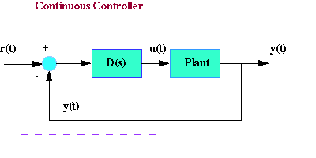
Blok dijagram kontinualnog sistema

Slide 3
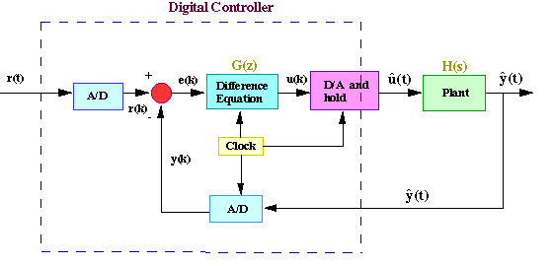
Blok dijagram DDC-a

Slide 4
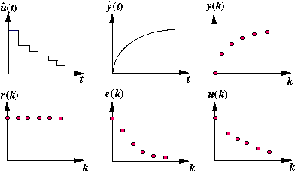
Tipovi signala

Slide 5
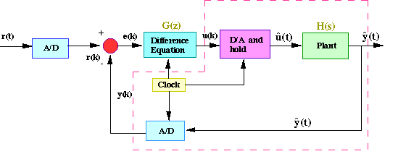
Diskretni ekvivalent sistema

Slide 6
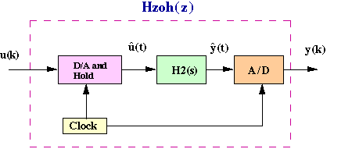
Diskretni ekvivalent sistema

Slide 7
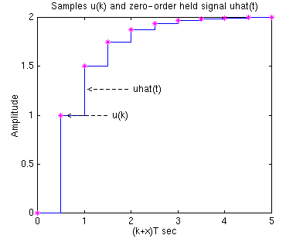
Pojam odabiranja i zadrške

Slide 8
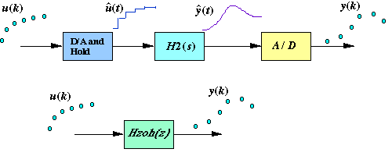
Diskretni ekvivalent sistema

Slide 9
HVALA NA PAŽNJI!
Pitanja?

