Slide 1
Virtual Instrumentation
Innovative Teaching Approaches in development of Software Designed Instrumentation and its application in real-time systems
Course modification IO8

Slide 2
Innovative Teaching Approaches in development of Software Designed Instrumentation and its application in real-time systems
Modifications to the course Virtual Instrumentation:
New lecture on databases in virtual instrumentation
New lecture on HOG video analysis tool in LabVIEW (UBG contribution)
New lecture on using generic non NI hardware in combination with LabVIEW
Video materials for points a) and c).

Slide 3
Innovative Teaching Approaches in development of Software Designed Instrumentation and its application in real-time systems

Slide 4
Virtual Instrumentation
Innovative Teaching Approaches in development of Software Designed Instrumentation and its application in real-time systems
Databases in virtual instrumentation

Slide 5
Innovative Teaching Approaches in development of Software Designed Instrumentation and its application in real-time systems
Ss. Cyril and Methodius
University
Faculty of Electrical Engineering
and Information Technologies
School of Electrical
Engineering
University of Belgrade
Faculty of Technical
Sciences
Zagreb University of
Applied Sciences
Faculty of Physics
Warsaw University of Technology

Slide 6
Database
Innovative Teaching Approaches in development of Software Designed Instrumentation and its application in real-time systems
Collection of data organized in tables
Relational Database Management System (RDBMS)
Oracle RDBMS
MySQL Relational DBMS
Microsoft SQL Server
PostgreSQL
SQLite, Apache Derby, H2

Slide 7
Relational database
tables (relations) have a specific relationship
primary key - one or multiple columns in a table that uniquely identifies a table row
foreign key – a column in a table in which it is not a primary key, but is a primary key in another table (uniquely identifies a row in another table)

Slide 8
Normalization
rules that must be respected when designing a relational database
keeps integrity
Functional dependency
„The two columns A and B within a table are functionally dependent (A-> B) if two rows of a table with the same value of column A imply the same value in column B.”
Normal forms
First normal form
Second normal form
Third normal form
other normal forms…

Slide 9
SQL
standardized language
retrieving data from DB
manipulating data inside DB
creating tables
deleting tables
JOIN mechanism
CROSS JOIN
INNER JOIN
OUTER JOIN
Transactions
needed when changing the data of one table may affect the data within one or more other tables

Slide 10
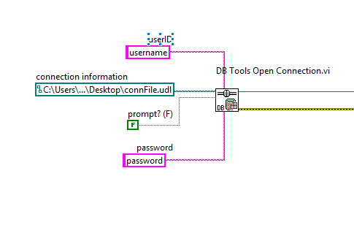
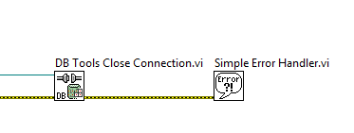
Labview Database Connectivity Toolkit
establishing connection
DB Tools Open Connection VI
connection information:
prompt window
UDL file
contains connection information
closing connection
DB Tools Close Connection VI

Slide 11
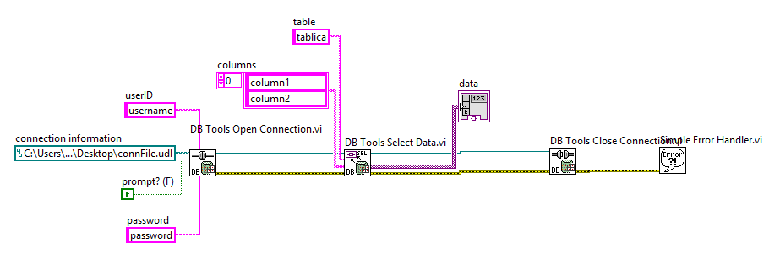
Retrieve data from database (1)
using DB Tools Select Data VI

Slide 12
Retrieve data from database (2)
using queries
DB Tools Execute Query VI
DB Tools Fetch Recordset Dana VI
DB Tools Free Object

Slide 13
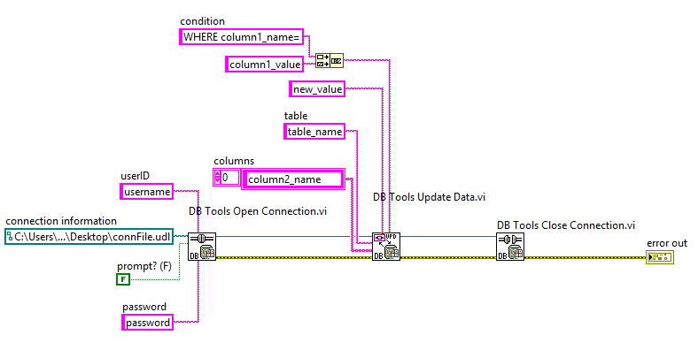
Update table in database
DB Tools Update Dana VI
condition (where clause)

Slide 14
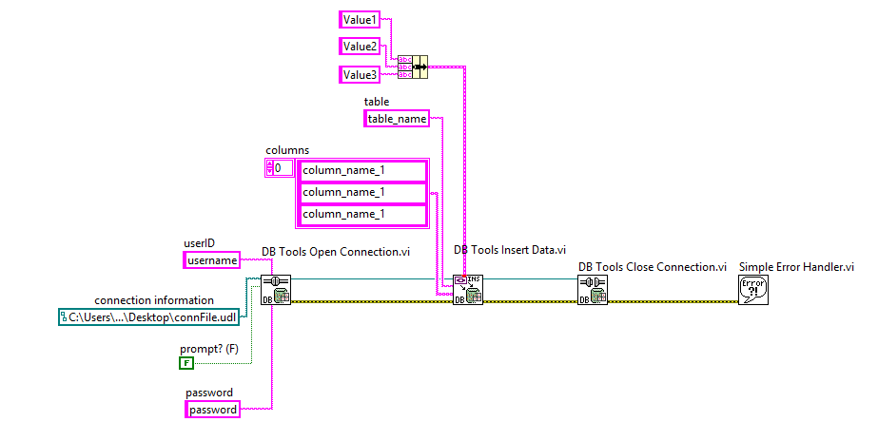
Insert data to database (1)
DB Tools Insert Data VI
single row

Slide 15
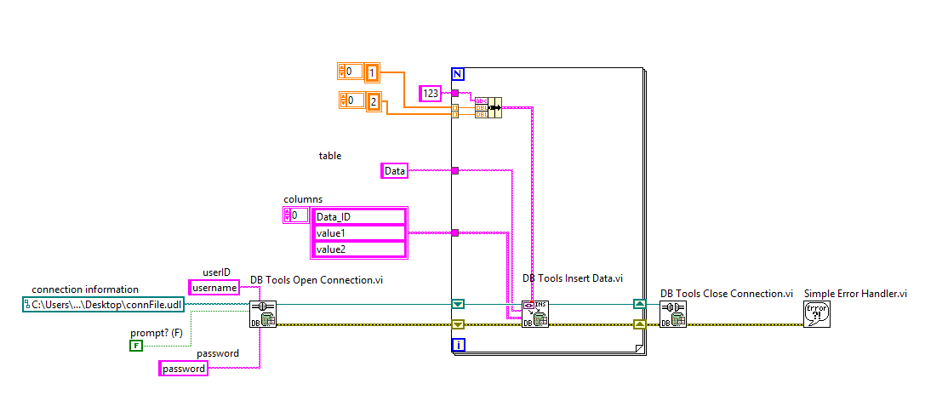
Insert data to database (2)
multiple values insertion

Slide 16
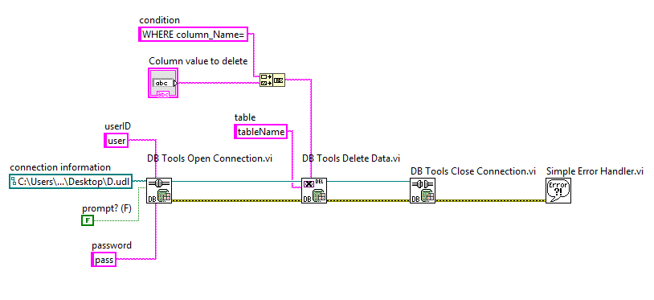
Delete data in the database
DB Tools Delete Dana VI
condition (where clause)

Slide 17
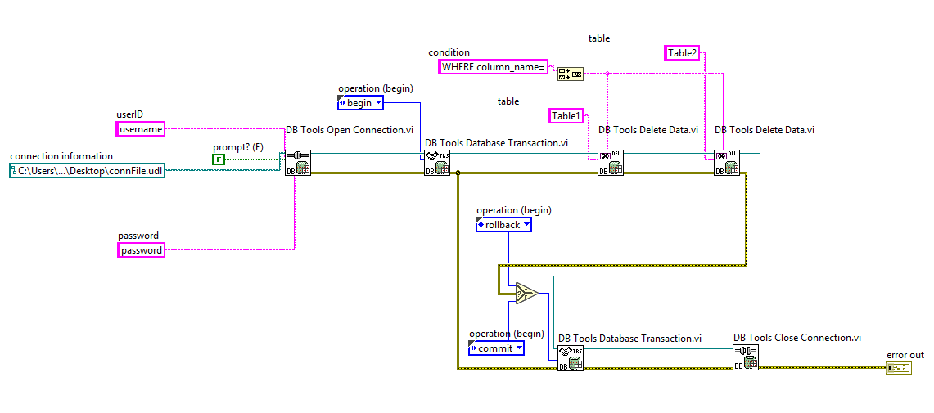
Transaction
DB Tools Database Transaction VI
begin, rollback, commit

Slide 18
Innovative Teaching Approaches in development of Software Designed Instrumentation and its application in real-time systems
Thanks!

Slide 19
Innovative Teaching Approaches in development of Software Designed Instrumentation and its application in real-time systems
Histogram of Oriented Gradients (HOG)
A Picture Analysis Method
The European Commission's support for the production of this publication does not constitute an endorsement of the contents, which reflect the views only of the authors, and the Commission cannot be held responsible for any use which may be made of the information contained therein.

Slide 20
Innovative Teaching Approaches in development of Software Designed Instrumentation and its application in real-time systems
Ss. Cyril and Methodius
University
Faculty of Electrical Engineering
and Information Technologies
School of Electrical
Engineering
University of Belgrade
Faculty of Technical
Sciences
Zagreb University of
Applied Sciences
Faculty of Physics
Warsaw University of Technology

Slide 21
Histogram of Oriented Gradients (HOG)
Innovative Teaching Approaches in development of Software Designed Instrumentation and its application in real-time systems
The basic purpose of this analysis method is feature extraction from a picture
The method is very good at detecting shapes
It is not locally oriented, but extracts features for the whole picture

Slide 22
HOG algorithm
Innovative Teaching Approaches in development of Software Designed Instrumentation and its application in real-time systems
The picture is analysed by dividing the pictures into subsections
Cells are usually defined as groups of 8×8 pixels
They are then combined into blocks of 4×4 cells
These values are not fixed, but established as general guidelines

Slide 23
HOG algorithm
Innovative Teaching Approaches in development of Software Designed Instrumentation and its application in real-time systems
For each cell a polar coordinate system is defined with the pole at the center of the cell
A fixed number of orientation bins is selected (usually 9)
The bins represent discrete directions for lines from 0°-180°
Each pixel in the cell adds weight to a corresponding direction, depending on it’s magnitude (intensity for simple greyscale picture)
The value of a pixel influences of the 4 nighbouing cells as well with a reduced weight

Slide 24
HOG algorithm
Innovative Teaching Approaches in development of Software Designed Instrumentation and its application in real-time systems
The result of this algorithm is a snowflake like shape positioned at the center of each cell
The snowflake consists of 9 lines (for as many bins) crossing at the cell center
The length of the lines determines the dominance of the shape direction for a certain cell (and the 4 neighbouring cells with a reduced weight)
In variation to the basic approach the line intensity can be proportionate to it’s length so that the dominance of diretction is doubly accentuated

Slide 25
HOG algorithm cell results
Innovative Teaching Approaches in development of Software Designed Instrumentation and its application in real-time systems
A single cell HOG result is displayed to the right
This variant establishes dominance through line length, not intensity
It follows from the picture that for this cell the dominant directions were close to the horizontal and vertical, while other directions are not significantly represented
HOG flake

Slide 26
HOG algorithm cell results
Innovative Teaching Approaches in development of Software Designed Instrumentation and its application in real-time systems
A single cell HOG result is displayed to the right
In this case the direction dominance is emphasized by the intensity of the line (longer lines are whiter)
Intensity HOG flake

Slide 27
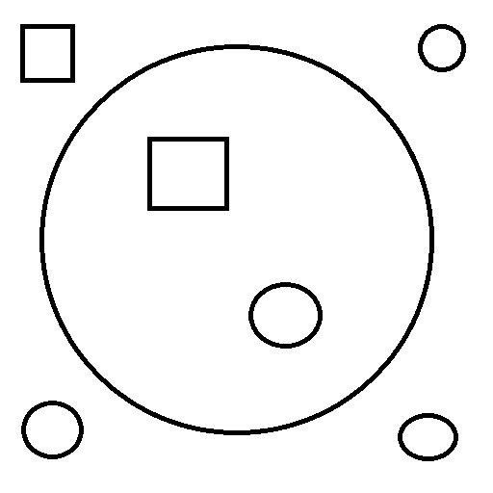
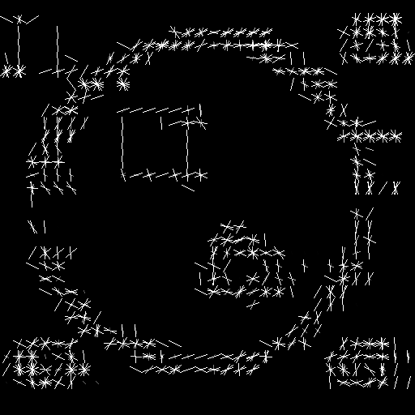
HOG algorithm full picture results
Innovative Teaching Approaches in development of Software Designed Instrumentation and its application in real-time systems

Slide 28
HOG algorithm full picture results
Innovative Teaching Approaches in development of Software Designed Instrumentation and its application in real-time systems

Slide 29
HOG algorithm full picture results
Innovative Teaching Approaches in development of Software Designed Instrumentation and its application in real-time systems

Slide 30
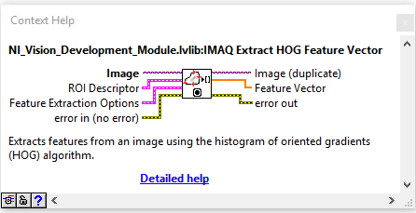
HOG method in LabVIEW
Innovative Teaching Approaches in development of Software Designed Instrumentation and its application in real-time systems
The algorithm is implemented in Vision module in LabVIEW
It is very badly documented
There is little instruction other than those available in Context Help

Slide 31
HOG method in LabVIEW inputs
Innovative Teaching Approaches in development of Software Designed Instrumentation and its application in real-time systems
The algorithm can be applied on the whole picture (Default) or a Region Of Interest can be defined through input cluster ROI Descriptor
Feature Extraction Options input cluster defines cell size (X×Y) and the number of direction bins

Slide 32
HOG method in LabVIEW output
Innovative Teaching Approaches in development of Software Designed Instrumentation and its application in real-time systems
Feature Vector is a 1D array of doubles that includes line lengths for different bins consecutively for all the cells consecutively
If you have 20 × 30 cells image and 9 bines the array will contain 5400 elements

Slide 33
HOG method in LabVIEW bin order
Innovative Teaching Approaches in development of Software Designed Instrumentation and its application in real-time systems
Taking the standard compass orientation (North as up) the first position bin value for each cell is North following by bin (direction) values over West toward South
This is very important when trying to visualize HOG method results properly
This presentation is accompanied with a LabVIEW example program for testing the HOG method and experimenting with different method parametrization

Slide 34
Innovative Teaching Approaches in development of Software Designed Instrumentation and its application in real-time systems
Thanks!

Slide 35
Virtual Instrumentation
Innovative Teaching Approaches in development of Software Designed Instrumentation and its application in real-time systems
Using non-NI hardware with Labview - LECTURE

Slide 36
Innovative Teaching Approaches in development of Software Designed Instrumentation and its application in real-time systems
Ss. Cyril and Methodius
University
Faculty of Electrical Engineering
and Information Technologies
School of Electrical
Engineering
University of Belgrade
Faculty of Technical
Sciences
Zagreb University of
Applied Sciences
Faculty of Physics
Warsaw University of Technology

Slide 37
Arduino
open-source platform
widely used
can be programmed using specialized IDE
low cost
different models
uno, mega, nano
Inputs & outputs
depend on the model
digital IO
PWM, interrupt, I2C, SPI, etc.
analog IO

Slide 38
Raspberry PI
small single-board computer
different generations
1, 2, 2B, 3, 3B, 4 (latest version)
runs real-time operating system
Rasbian (linux debian distribution)
low cost
multiple general-purpose input/output pins (GPIO)
number depends on the model

Slide 39
Communication with the third-party harware
communication protocol
between Labview environment and third-party software
LINX framework
add-on for Labview
real-time deployment (LINX Application builder)
Labview runtime on the target device (third-party software)

Slide 40
Communication protocol
serial
network
(TCP/IP)
Bluetooth
etc..
a lot of programming on the both sides of the communication channel
new application protocol needs to be defined

Slide 41
Linx Framework
free framework
installation via Package Manager
good set of libraries
ideal for:
students home projects and learning Labview
prototyping
Arduino can be used as acquisition device
not a real-time system
requires constant connection to the computer running Labview
limitations when using libraries
if the library is not working not much to do
development stopped in 2016

Slide 42
Real-time deployment (LINX Application builder)
Programming in Labview using LINX framework
running the code on the Raspberry PI without the connection to the computer with the Labview environment
Labview runtime engine is installed on the target device
VI is started on the startup of the target device

Slide 43
Digital I/O example
VI that reads a digtal input signal (for example a button)
based on the input signal toggle two digital outputs with opposite values (for example a DC motor driver)

Slide 44
PWM control example
Vi that controls the intensity of the LED connected to the digital pin 3 of the target device.

Slide 45
Servo motor control example
Control the servo motor connected to the digital pin 9 of the target device

Slide 46
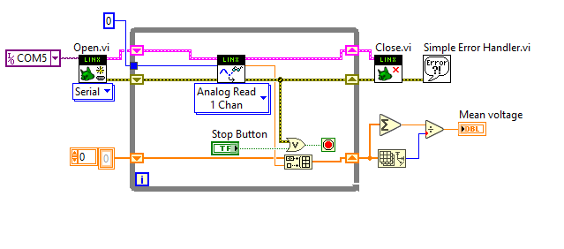
Analog I/O example
VI that reads analog value from the analog input pin 0 and stores it in an array. VI displays the arithmetic mean of the read values to the user.

Slide 47
RealTime application on Raspberry PI (1)
requirements are:
Labview 2014 sp1, 32 bit
MakerHub add-on for Labview
Rasbian OS on Raspberry PI
Raspbian Jessie
Connection tto Raspberry PI
Serial, network (WiFi, Ethernet cable)
for network communication SSH protocol is used
it needs to be enabled on the Raspberry

Slide 48
RealTime application on Raspberry PI (2)
install the Labview runtime on the Raspberry PI
automatically with the MakerHub add-on
building the application for the target device
deploying the application
runnig the application on the device startup
restarting the target device

Slide 49
Innovative Teaching Approaches in development of Software Designed Instrumentation and its application in real-time systems
Thanks!

