Slide 1
Virtual Instrumentation
Innovative Teaching Approaches in development of Software Designed Instrumentation and its application in real-time systems
Using non-NI hardware with Labview - LECTURE

Slide 2
Innovative Teaching Approaches in development of Software Designed Instrumentation and its application in real-time systems
Ss. Cyril and Methodius
University
Faculty of Electrical Engineering
and Information Technologies
School of Electrical
Engineering
University of Belgrade
Faculty of Technical
Sciences
Zagreb University of
Applied Sciences
Faculty of Physics
Warsaw University of Technology

Slide 3
Arduino
open-source platform
widely used
can be programmed using specialized IDE
low cost
different models
uno, mega, nano
Inputs & outputs
depend on the model
digital IO
PWM, interrupt, I2C, SPI, etc.
analog IO

Slide 4
Raspberry PI
small single-board computer
different generations
1, 2, 2B, 3, 3B, 4 (latest version)
runs real-time operating system
Rasbian (linux debian distribution)
low cost
multiple general-purpose input/output pins (GPIO)
number depends on the model

Slide 5
Communication with the third-party harware
communication protocol
between Labview environment and third-party software
LINX framework
add-on for Labview
real-time deployment (LINX Application builder)
Labview runtime on the target device (third-party software)

Slide 6
Communication protocol
serial
network
(TCP/IP)
Bluetooth
etc..
a lot of programming on the both sides of the communication channel
new application protocol needs to be defined

Slide 7
Linx Framework
free framework
installation via Package Manager
good set of libraries
ideal for:
students home projects and learning Labview
prototyping
Arduino can be used as acquisition device
not a real-time system
requires constant connection to the computer running Labview
limitations when using libraries
if the library is not working not much to do
development stopped in 2016

Slide 8
Real-time deployment (LINX Application builder)
Programming in Labview using LINX framework
running the code on the Raspberry PI without the connection to the computer with the Labview environment
Labview runtime engine is installed on the target device
VI is started on the startup of the target device

Slide 9
Digital I/O example
VI that reads a digtal input signal (for example a button)
based on the input signal toggle two digital outputs with opposite values (for example a DC motor driver)

Slide 10
PWM control example
Vi that controls the intensity of the LED connected to the digital pin 3 of the target device.

Slide 11
Servo motor control example
Control the servo motor connected to the digital pin 9 of the target device

Slide 12
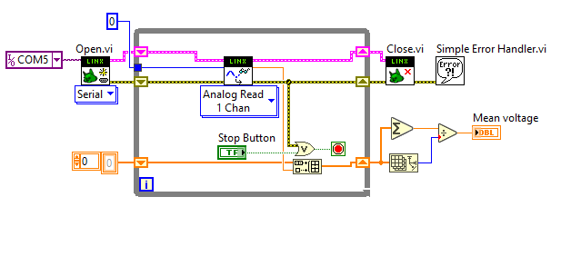
Analog I/O example
VI that reads analog value from the analog input pin 0 and stores it in an array. VI displays the arithmetic mean of the read values to the user.

Slide 13
RealTime application on Raspberry PI (1)
requirements are:
Labview 2014 sp1, 32 bit
MakerHub add-on for Labview
Rasbian OS on Raspberry PI
Raspbian Jessie
Connection tto Raspberry PI
Serial, network (WiFi, Ethernet cable)
for network communication SSH protocol is used
it needs to be enabled on the Raspberry

Slide 14
RealTime application on Raspberry PI (2)
install the Labview runtime on the Raspberry PI
automatically with the MakerHub add-on
building the application for the target device
deploying the application
runnig the application on the device startup
restarting the target device

Slide 15
Innovative Teaching Approaches in development of Software Designed Instrumentation and its application in real-time systems
Thanks!

