Slide 1
Workshop – Video Acquisition, Processing and Data Acquisition
Innovative Teaching Approaches in development of Software Designed Instrumentation and its application in real-time systems
Ss. Cyril and Methodius
University
Faculty of Electrical Engineering
and Information Technologies
School of Electrical
Engineering
University of Belgrade
Faculty of Technical
Sciences
Zagreb University of
Applied Sciences
Faculty of Physics
Warsaw University of Technology

Slide 2
Instructors
Tomislav Novak, mag. ing. inf. et comm. techn.
Ivan Lujo, dipl. ing. el.

Slide 3
WHY LabVIEW?
Intended for non-programmers
Graphical user interface
intuitive logic implementation
Dataflow
result is a program (virtual instrument) just like any other program
possibility of creating complex project

Slide 4
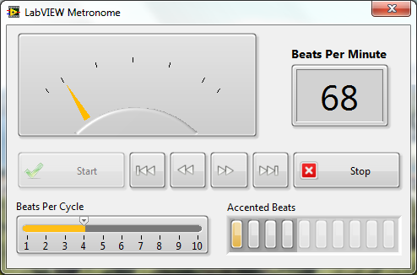
Front panel
User interface

Slide 5
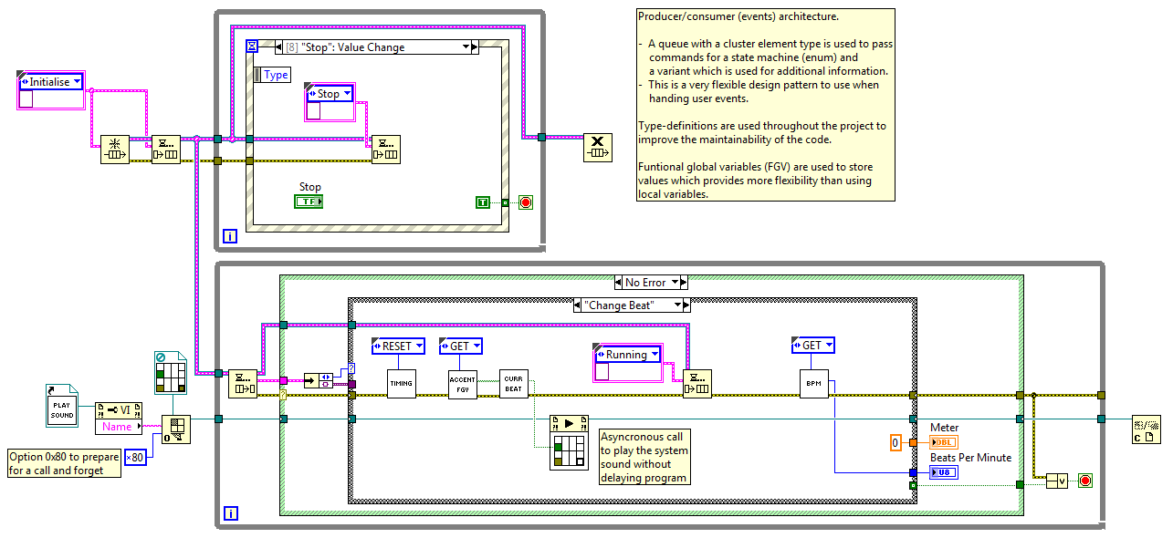
Block diagram
for functionality implementation

Slide 6
Data acquisition and analisys
one of the main applications of Labview environment
requires acquisition devices
official devices can sometimes be too expensive for individual to start working in Labview
cheaper:
myDAQ
myRIO
NI USB
possibility to use third party acquisition devices
LINX
communication: serial, network, …
real-time deployment

Slide 7
LINX – Arduino
steps:
Installing the MakerHub add-on for labview
installing drivers for arduino board
uploading firmware to the bord through Labview environement

Slide 8
LINX – Arduino: pros/cons
pros:
good set of libraries
sometimes can also be a drawback
cheap hardware
ideal for:
students home projects and learning Labview
prototyping
cons:
acquisition device - not a real-time system
requires constant connection to the computer running Labview
limitations when using libraries
support stopped

Slide 9
LINX – Raspberry PI
steps:
Installing Labview 2014 sp1, 32 bit
Installing the MakerHub add-on for labview using VI package manager
install Rasbian OS on Raspberry PI
it is more likely to work with Rasbian Jessie (version from April 2017)
connection to the Raspberry PI
Serial, network (WiFi, Ethernet cable)
it is used to interact with the application in non-real time applications
it is used to upload real-time application to the Raspberry PI

Slide 10
LINX – Raspberry PI: modes
Non real-time mode
works similar as the Arduino bord
Real-time mode
Labview runtime is installed on the Raspberry PI

Slide 11
Alternatives (1)
creating a protocol for communication with the microcontroller
Serial communication (NI-VISA)
network communication (TCP/IP)
…

Slide 12
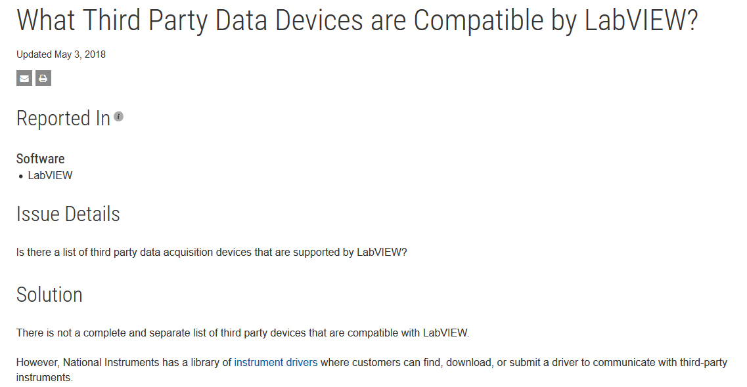
Alternatives (2)

