Slide 1
Virtual Instrumentation
Innovative Teaching Approaches in development of Software Designed Instrumentation and its application in real-time systems
Databases in virtual instrumentation

Slide 2
Innovative Teaching Approaches in development of Software Designed Instrumentation and its application in real-time systems
Ss. Cyril and Methodius
University
Faculty of Electrical Engineering
and Information Technologies
School of Electrical
Engineering
University of Belgrade
Faculty of Technical
Sciences
Zagreb University of
Applied Sciences
Faculty of Physics
Warsaw University of Technology

Slide 3
Database
Innovative Teaching Approaches in development of Software Designed Instrumentation and its application in real-time systems
Collection of data organized in tables
Relational Database Management System (RDBMS)
Oracle RDBMS
MySQL Relational DBMS
Microsoft SQL Server
PostgreSQL
SQLite, Apache Derby, H2

Slide 4
Relational database
tables (relations) have a specific relationship
primary key - one or multiple columns in a table that uniquely identifies a table row
foreign key – a column in a table in which it is not a primary key, but is a primary key in another table (uniquely identifies a row in another table)

Slide 5
Normalization
rules that must be respected when designing a relational database
keeps integrity
Functional dependency
„The two columns A and B within a table are functionally dependent (A-> B) if two rows of a table with the same value of column A imply the same value in column B.”
Normal forms
First normal form
Second normal form
Third normal form
other normal forms…

Slide 6
SQL
standardized language
retrieving data from DB
manipulating data inside DB
creating tables
deleting tables
JOIN mechanism
CROSS JOIN
INNER JOIN
OUTER JOIN
Transactions
needed when changing the data of one table may affect the data within one or more other tables

Slide 7
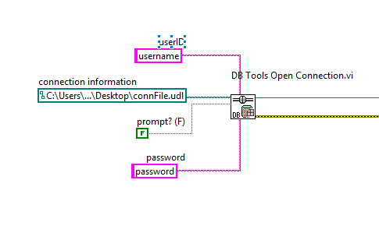
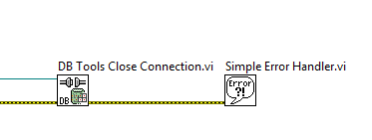
Labview Database Connectivity Toolkit
establishing connection
DB Tools Open Connection VI
connection information:
prompt window
UDL file
contains connection information
closing connection
DB Tools Close Connection VI

Slide 8
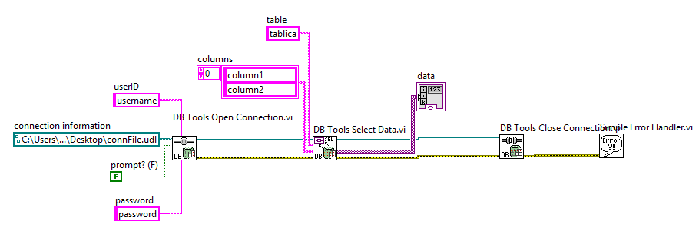
Retrieve data from database (1)
using DB Tools Select Data VI

Slide 9
Retrieve data from database (2)
using queries
DB Tools Execute Query VI
DB Tools Fetch Recordset Dana VI
DB Tools Free Object

Slide 10
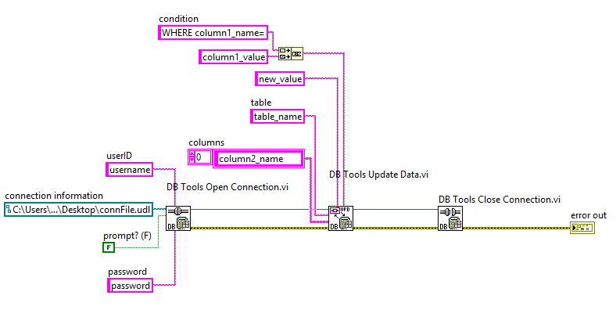
Update table in database
DB Tools Update Dana VI
condition (where clause)

Slide 11
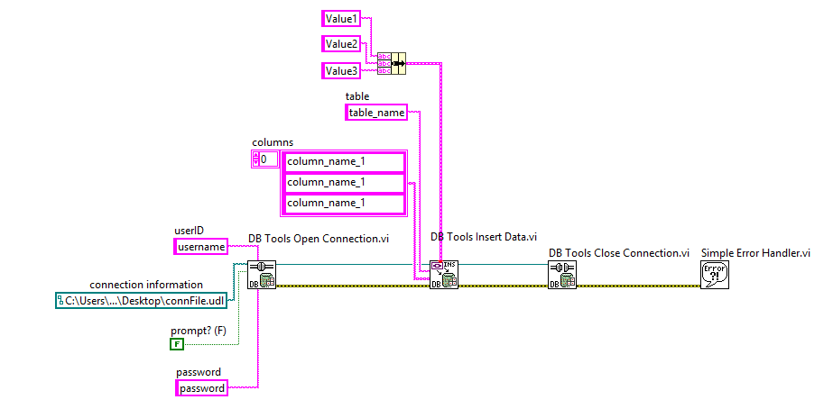
Insert data to database (1)
DB Tools Insert Data VI
single row

Slide 12
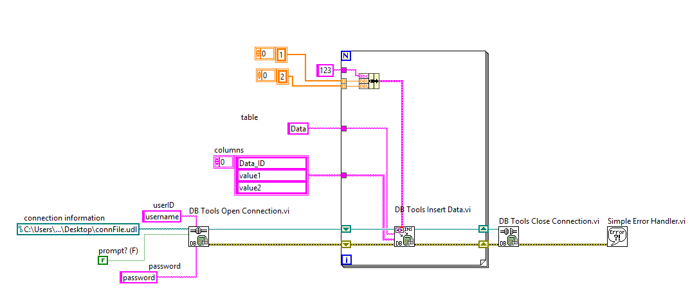
Insert data to database (2)
multiple values insertion

Slide 13
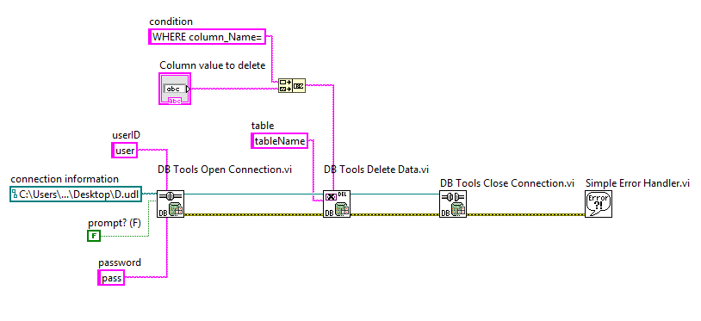
Delete data in the database
DB Tools Delete Dana VI
condition (where clause)

Slide 14
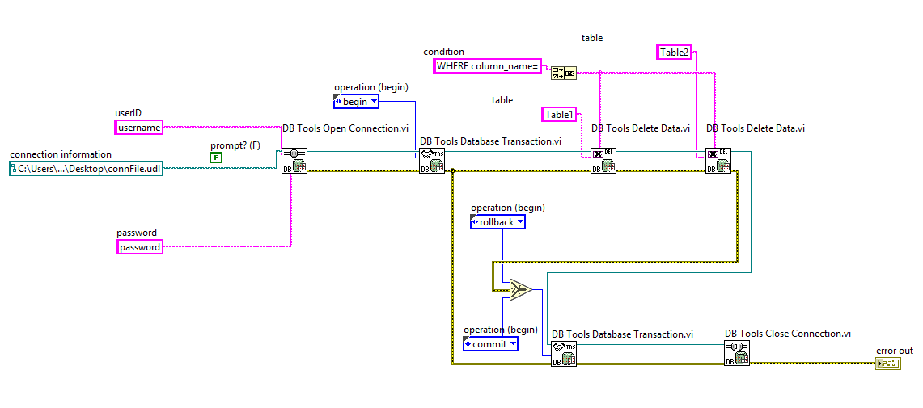
Transaction
DB Tools Database Transaction VI
begin, rollback, commit

Slide 15
Innovative Teaching Approaches in development of Software Designed Instrumentation and its application in real-time systems
Thanks!

